Slide 1
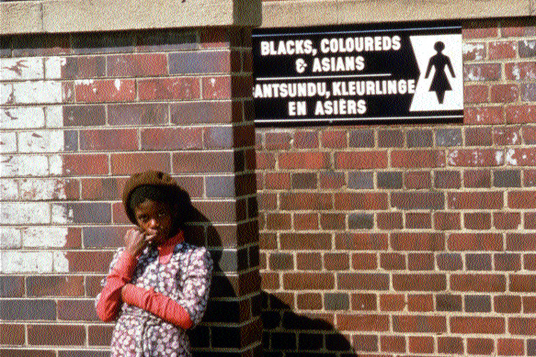
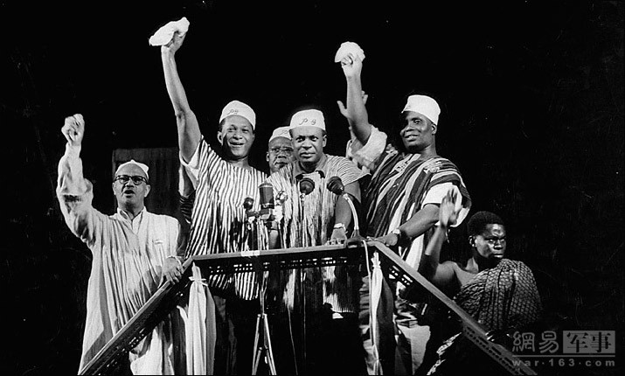
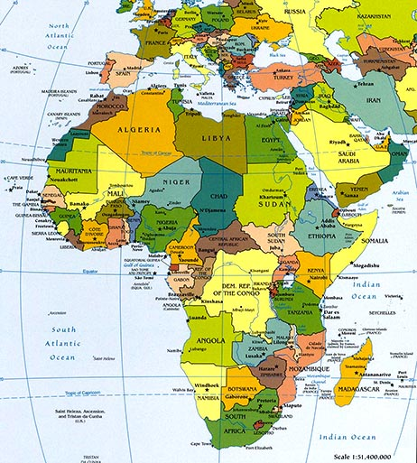
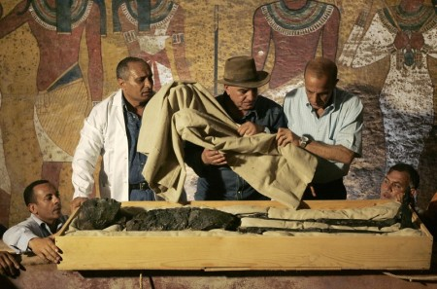
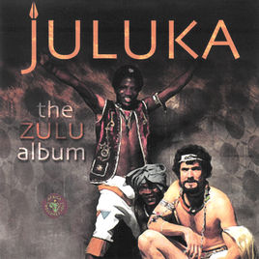
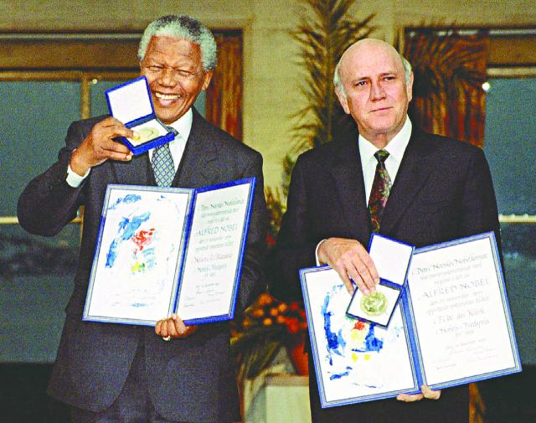
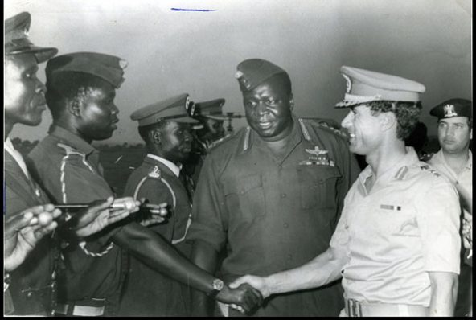

Famous Event in African

Slide 2
圖坦卡門的詛咒
The 1922 discovery by Howard Carter of Tutankhamun's early intact, funded by Lord Carnavon, received worldwide press coverage. It sparked a renewed public interest in ancient Egypt, for which Tutankhamun’s mask, now in the Egyptian Museum, remains the popular symbol.
1992年在Lord Carnarvon的資助之下，Howard Carter 發掘圖坦卡門近乎完整的陵墓，而這項創舉激起了群眾對於古埃及的興趣，許多人都想一睹圖坦卡門的神秘面紗。現在它被存放於埃及博物館，且仍被視為流行的象徵。

Slide 3
南非種族隔離
Apartheid was a system of institutionalized racial segregation and discrimination in South Africa between 1948 and 1991.
種族隔離是南非於1948年至1991年間的一個政策。它是一個涵蓋種族隔離和歧視的體制。

Slide 4
南非音樂的變革
In 20th century, the darkest era of African history, Jonny Clegg integrated traditional amaZulu music with European style and founded a band called Juluka. He went on tour around the world to show the prosperity of the combination of two cultures.
在20世纪80年代以及南非歷史上最黑暗的時期，Johnny Clegg將傳統的祖魯族歌舞融入歐洲風格，創建了一支名為Juluka的樂隊。他在南非和世界各地進行巡回演出，為人們展示了兩種文化共生共榮的景象。

Slide 5
非洲獨立年（1960年）
1960 is referred to as the Year of Africa because of a series of events that took place during the year—namely the independence of seventeen African nations—that highlighted the growing Pan-African sentiments in the continent. The year brought about the culmination of African independence movements and the subsequent emergence of Africa as a major force in the United Nations.
1960年又稱非洲獨立年，因為許多非洲國家都陸續獨立，而這也壯大了泛非主義這般的大陸情懷，就在那年非洲的獨立運動達到巔峰並且隨後非洲也成為聯合國的巨頭之一。

Slide 6
2010南非世足
The 2010 FIFA World Cup was the 19th FIFA World Cup. It took place in South Africa from 11 June to 11 July 2010. There were 32 teams and 64 matches. This session is the first time for African to held a world cup. There were over 320 billion audience watch the contest through televisions, which reaches the highest ratings in the history.
2010年國際足總世界盃（官方名稱：2010 FIFA World Cup South Africa）是國際足總第十九屆國際足總世界盃，於2010年6月11日至7月11日在南非舉行，由來自世界各地的 32 支球隊參加賽事，進行 64 場比賽決定冠軍隊伍。本屆是首次在非洲舉行的世界盃比賽。共有超過 320 億人次的觀眾通過電視直播觀看本屆賽事，成為歷史新高。

Slide 7
南非總統曼德拉1993年的諾貝爾和平獎
The Nobel Peace Prize 1993 was awarded jointly to Nelson Mandela and Frederik Willem de Klerk "for their work for the peaceful termination of the apartheid regime, and for laying the foundations for a new democratic South Africa"
1993年的諾貝爾和平獎由Nelson Mandela和Frederik Willem de Klerk獲得，因為他們的在和平上的貢獻和努力，終止了種族隔離和歧視，並且為南非的新民主立下了里程碑。

Slide 8
1978年烏坦戰爭
The Uganda–Tanzania war (usually referred to in Uganda as the Liberation War) was fought between Uganda and Tanzania in 1978–1979, and led to the overthrow of Idi Amin’s regime.
烏坦戰爭在1978至1979年於烏干達及坦桑尼雅開打，而這場戰役最終也成為推翻Idi Amin獨裁政權的契機。

