Slide 1
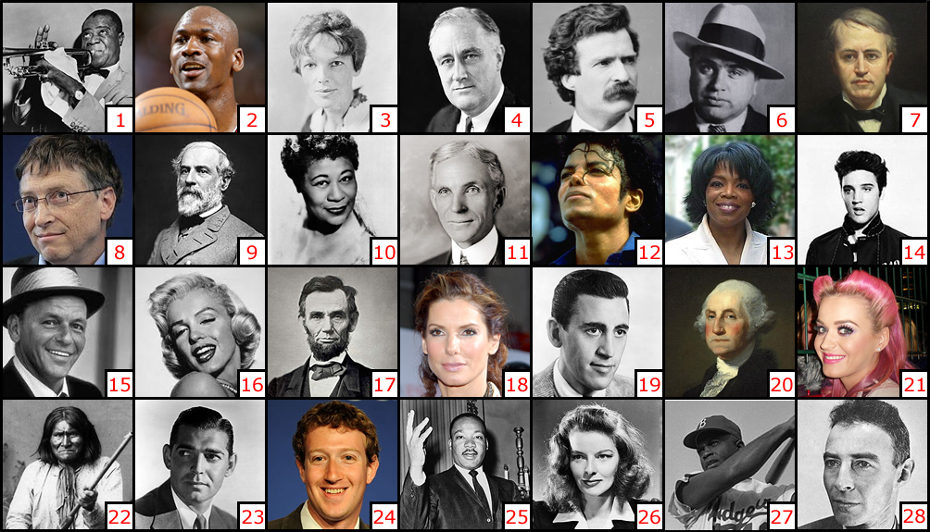
Famous north American people
陳映如 Ruby Chen

Slide 2
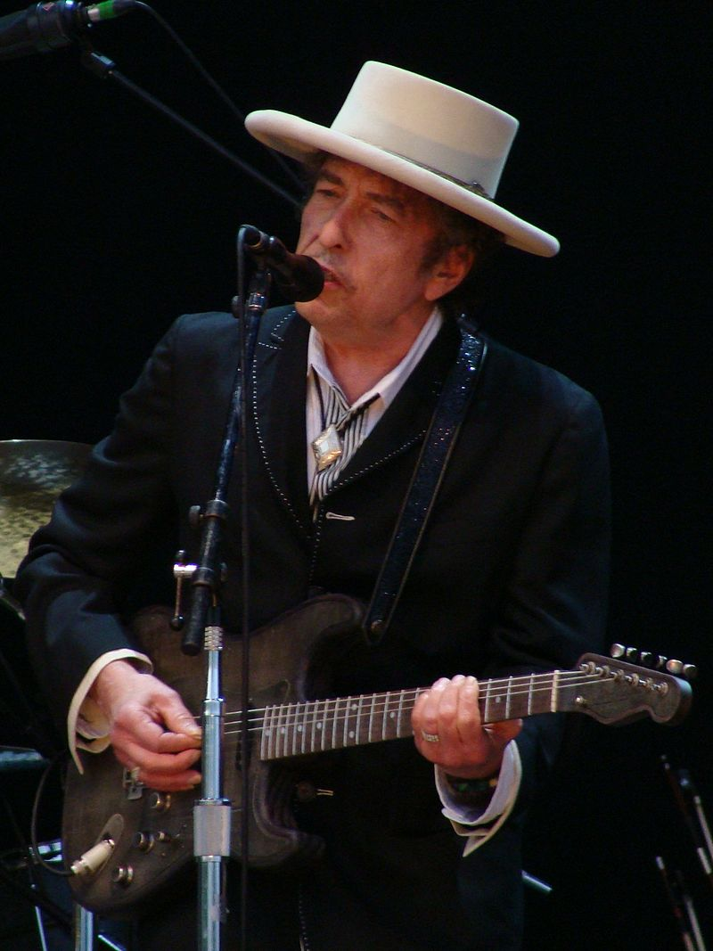
Bob Dylan
Got the Nobel Prize in Literature in 2016
巴布·狄倫被認為是20世紀美國最重要、最有影響力的民謠歌手，並被視為20世紀60年代美國民權運動的代言人。
他的部分早期作品成為了當時美國民權反戰運動的聖歌，例如《答案在風中飄》（Blowin' in the Wind）和《時代在變》（The Times They Are a-Changing）。
1960年代中期狄倫開始從原先的抗議民謠風格轉型，並在1965年發行長達六分鐘的單曲《像一塊滾石》（Like a Rolling Stone），也從此改變了流行音樂的傳統分類。

Slide 3
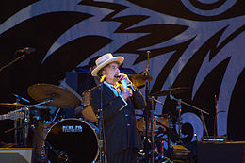
Bob Dylan is an American songwriter, singer, artist, and writer. He has been influential in popular music and culture for more than five decade.
Dylan's lyrics incorporate a wide range of political, social, philosophical, and literary influences.

Slide 4
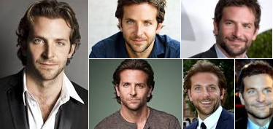
Bradley Cooper
布萊德利·庫柏
布萊德利·庫柏是一位美國男演員。知名代表作角色為《醉後大丈夫》的菲爾，電視影集《雙面女間諜》的威爾，喜劇電影《婚禮終結者》的塞克和影集《整形春秋》的艾丹史東。2010年出演《天龍特攻隊》電影版的小白。
The cinematic chameleon- He is an American actor and producer.
Cooper has also been nominated for two British Academy Film Awards and two Golden Globe Awards. Time magazine named him one of the 100 most influential people in the world in 2015.

Slide 5
Famous south
American people
陳映如 Ruby Chen

Slide 6
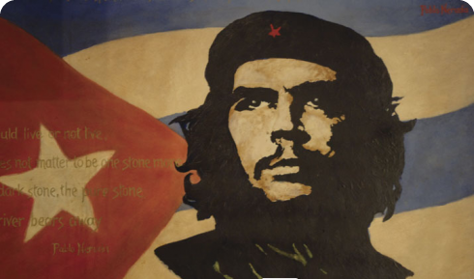
Che Guevara
A world famous rebel and revolutionary
切·格瓦拉
(著名的國際共產主義革命家、軍事理論家、政治家、醫生、作家、遊擊隊領導人)
Born in Argentina in 1928.
He was a doctor, soldier. A great adventurer, the first to cross South America on a scooter.
After the successful Revolution on Cuba he took an active part in building Socialism.
Che was a dear friend of Fidel Castro, the president of Cuba. In 1959 he became a president of National Cuban Bank, in 1961 the Minister of Industry.
In November 1966 he went to Bolivia to organize guerilla movement. Same year he was surrounded and kaput by the state army that took a great support from the US army. His portrait is considered to be one of the most replicate images, including the image of Jesus Christ.

Slide 7
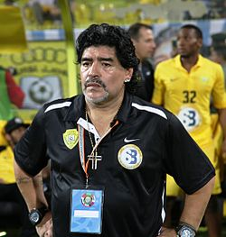
Diego Maradona
迪亞哥·馬拉度納
born in 1960 - Argentinian brilliant footballer, coach.
World champion 1986, he participated in four World Championships (1982, 1986, 1990 и 1994).
He started his career at the age of 16 and at 36 became the most popular footballer of the world. Maradona played for “Barcelona”, “Napoli”, “Sevilla”. Spent 36 matches for the national team and nailed 91 goals. He is also known as a “God’ s hand” for scoring a goal in Final 86 with his hand.
生於阿根廷首都布宜諾斯艾利斯，暱稱「世紀球王」、「球場上帝」，已退役的阿根廷足球運動員和教練，世界足球史上最優秀亦是最具爭議的球員。 是世界球壇中的傳奇巨星之一。

Slide 8
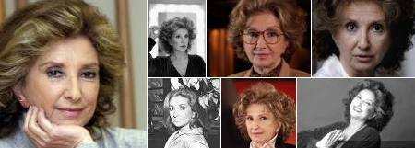
Norma Aleandro 諾瑪·阿萊昂德羅
A great example of beauty, character and talent is Norma Aleandro.
She is a famous actress, born in Buenos Aires.
A performer of leading roles, lately she has been shooting in international movies.
She worked in theatre and on the television. Norma got a palm branch on the Cans festival for the role in the “Official version”.

