Slide 1

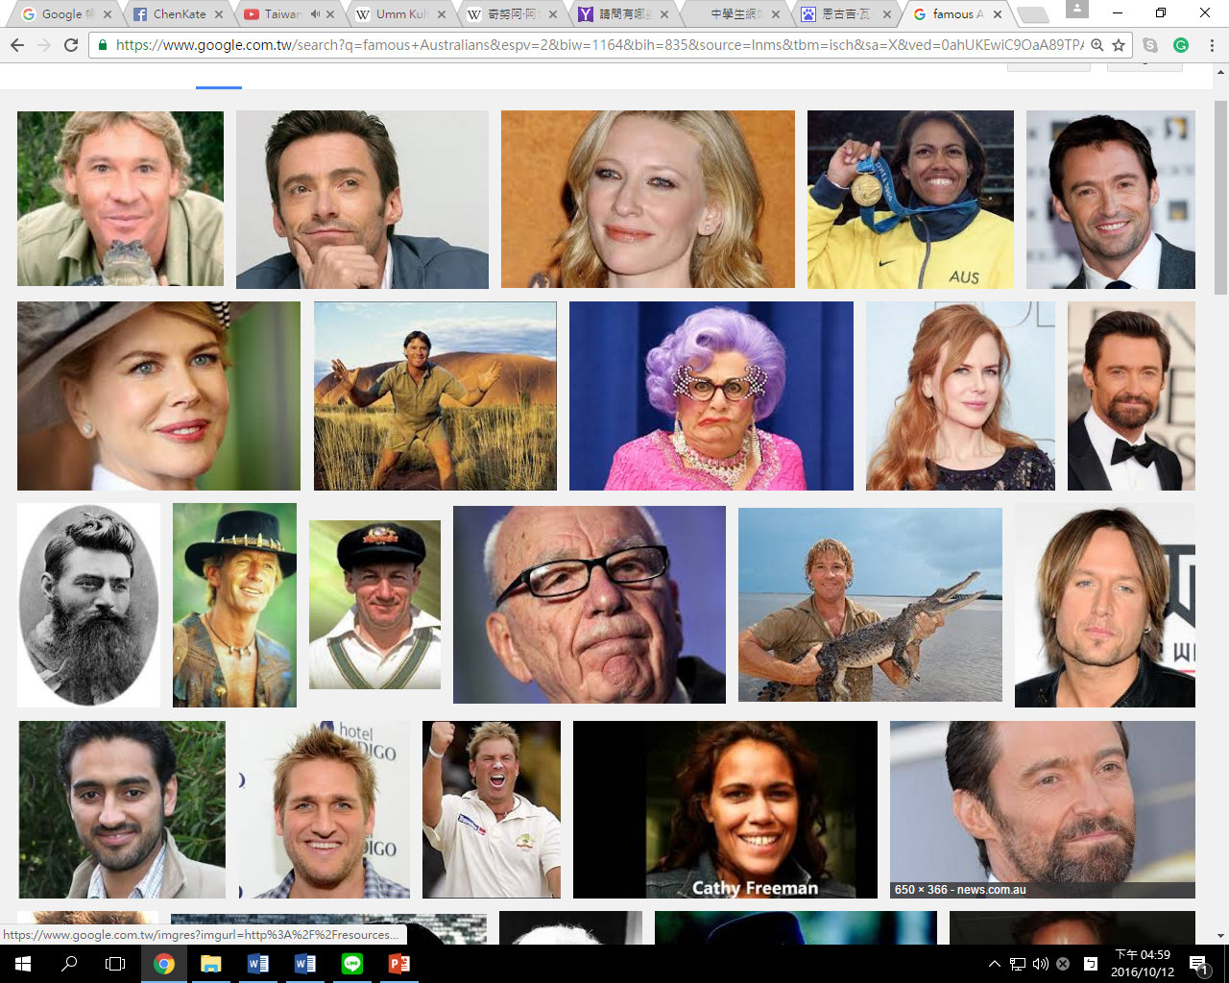
Famous people in Australia
Kate Chen 陳美珊

Slide 2
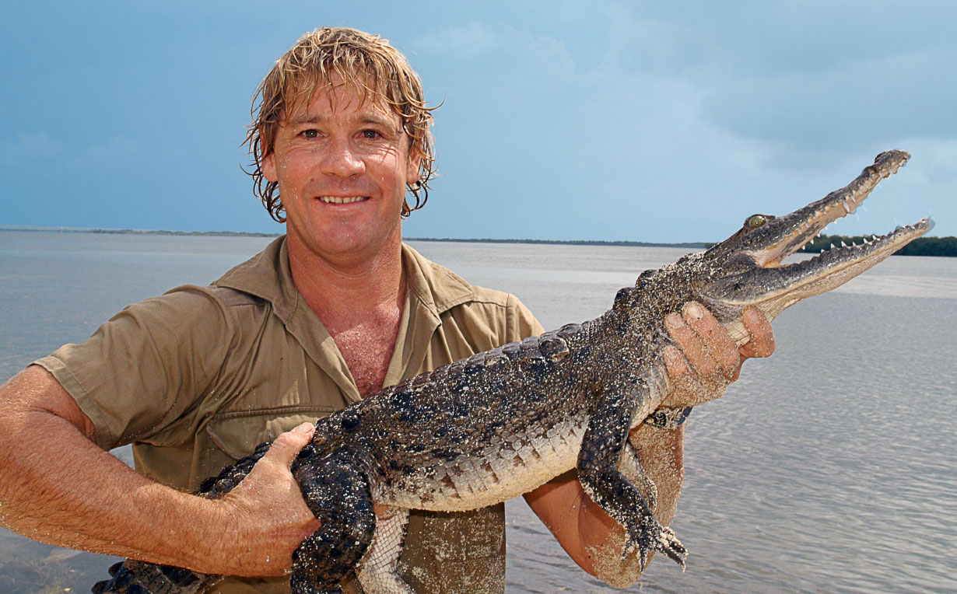
自然資源保護學家conservationist
Stephen Robert “Steve” Irwin (1962 – 2006), nicknamed "The Crocodile Hunter", was an Australian wildlife expert, television personality, and conservationist. Irwin achieved worldwide fame from the television series The Crocodile Hunter, an internationally broadcast wildlife documentary series which he co-hosted with his wife Terri. Together, the couple also owned and operated Australia Zoo, founded by Irwin's parents in Beerwah, about 80 kilometres (50 mi) north of the Queensland state capital city of Brisbane.
史提芬·勞勃·「史蒂夫」·歐文（1962－2006），澳洲環保人士與電視節目主持人。最廣為人知的節目就是與妻子一起主持的「鱷魚拍檔」，這也是他的外號鱷魚先生的由來，這是一個非傳統的動物紀錄片節目。史蒂夫·歐文在節目中誇張、滑稽的主持和對待動物的方式，使他成為國際上知名的人物，美國新聞還將他列為星期人物報導。儘管他的個人風格不受澳洲人重視，但帶有濃厚的澳洲英語口音，廣大知名度使他成為澳洲的代表之一。他的生日跟母親 Lyn 是同一天，他的爸爸 Bob 也是保育人士。

Slide 3

政治人物 politicians
寶琳·韓森（Pauline Hanson，1954年－）澳大利亞政治人物，極右派政黨單一民族黨創始人和黨魁，1996-1998年任國會議員。先任昆士蘭州參議員。政治理念是右翼、保守、反有色人種移民、反對多元文化，反對新移民在多元文化社會中保持自己的語言和文化，反對給予少數族裔政治上的優待。此黨人數較少但堅定的支持者群體，支持保衛歐裔白人在澳大利亞的主體地位。2006年，她曾被《時代》雜誌選為100個最具影響力的澳洲人之一。Pauline Lee Hanson 1954 – ) is an Australian politician. Pauline Hanson is one of Australia’s most well known politicians. Her reputation and recognition extends outside of Australia and reaches across the globe. She was chosen as one of the top 100 most influential people by Time Magazine in 2006.

Slide 4
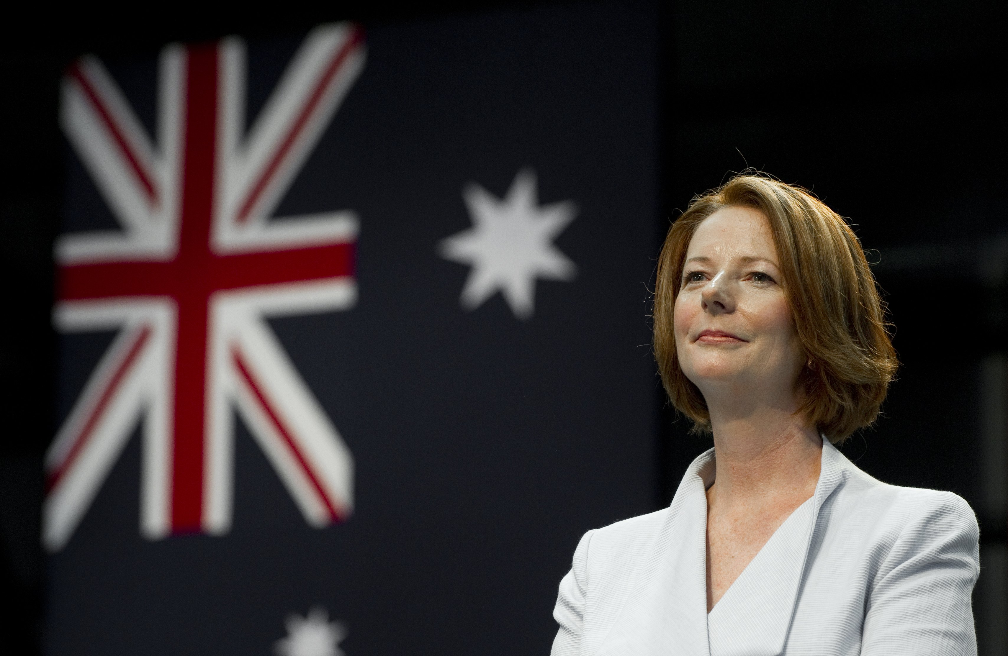
朱莉亞·艾琳·吉拉德（1961－），前任澳大利亞總理（第27任）、前任澳大利亞工黨聯邦領袖，也是澳大利亞首位女性總理、首位女性副總理及澳大利亞工黨首位女性黨魁。Julia Eileen Gillard (born 29 September 1961) is a former Australian politician who served as the 27th Prime Minister of Australia from 2010 to 2013, as leader of the Australian Labor Party. She was the first and to date only woman to hold the positions of deputy prime minister, prime minister and leader of a major party in Australia.

Slide 5
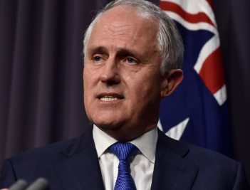
麥肯·布萊·滕博爾（Malcolm Bligh Turnbull，1954－，澳大利亞當地譯譚保），澳洲政治人物，現任澳洲總理、澳大利亞自由黨黨魁。他是雪梨東區溫特沃思選區（Wentworth）的議員。曾於2008－2009年任澳洲反對黨領袖；2013-2015年擔任通訊部長。從政前，他曾是大律師和投資銀家，身價過億，曾是澳洲政界中的首富。2015年9月，獲總督正式任命為澳洲第29任總理。Malcolm Bligh Turnbull (born 24 October 1954) is the 29th and current Prime Minister of Australia and the Leader of the Liberal Party. He assumed both offices after defeating Tony Abbott in a leadership spill on 14 September 2015.

Slide 6
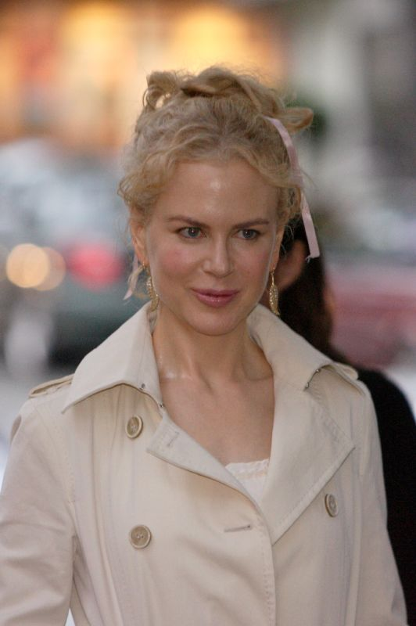
演藝人員 entertainers
Nicole Kidman (1967 – ) is an Australian actress and film producer. Kidman's breakthrough roles were in the 1989 feature film thriller Dead Calm and television thriller miniseries Bangkok Hilton. She came to worldwide recognition for her performances in the stock-car racing film Days of Thunder (1990), the romance-drama Far and Away (1992), and the hero film Batman Forever (1995).
妮可·基嫚，（英語：Nicole Kidman，1967年6月20日－），是一位女演員，她著名的是澳大利亞電影。生於美國夏威夷，兒時隨父母移民澳洲墨爾本。2002年，以《時時刻刻》(The Hours)獲第75屆奧斯卡最佳女主角獎，一度是好萊塢一姐，好萊塢最有權力的女人。

Slide 7
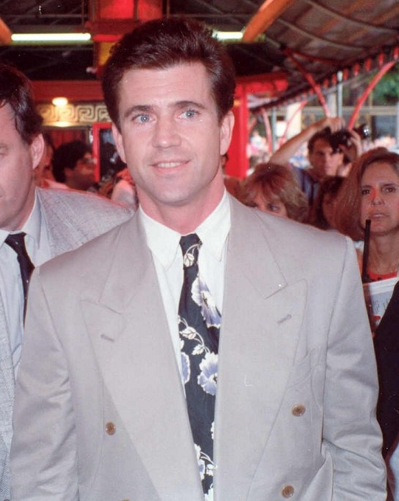
Mel Gibson (born January 3, 1956) is an American actor and filmmaker. He was born in Peekskill, New York, and moved with his parents to Sydney, Australia, when he was 12 years old. Gibson is best known as an action hero, for roles such as Martin Riggs in the Lethal Weapon buddy cop film series. In 1995, Gibson produced, directed, and starred in the epic historical drama film Braveheart, for which he won the Golden Globe and Academy Award for Best Director, along with the Academy Award for Best Picture. In 2004, he directed and produced the financially successful and controversial, biblical drama film The Passion of the Christ.梅爾·吉勃遜（Mel Colm-Cille Gerard Gibson，1956年1月3日－）是一位美籍愛爾蘭裔澳大利亞電影演員、導演及製片。他的著名作品有電影系列《衝鋒飛車隊》、《梅爾吉勃遜之英雄本色》和他導演的《耶穌受難記》。

Slide 8
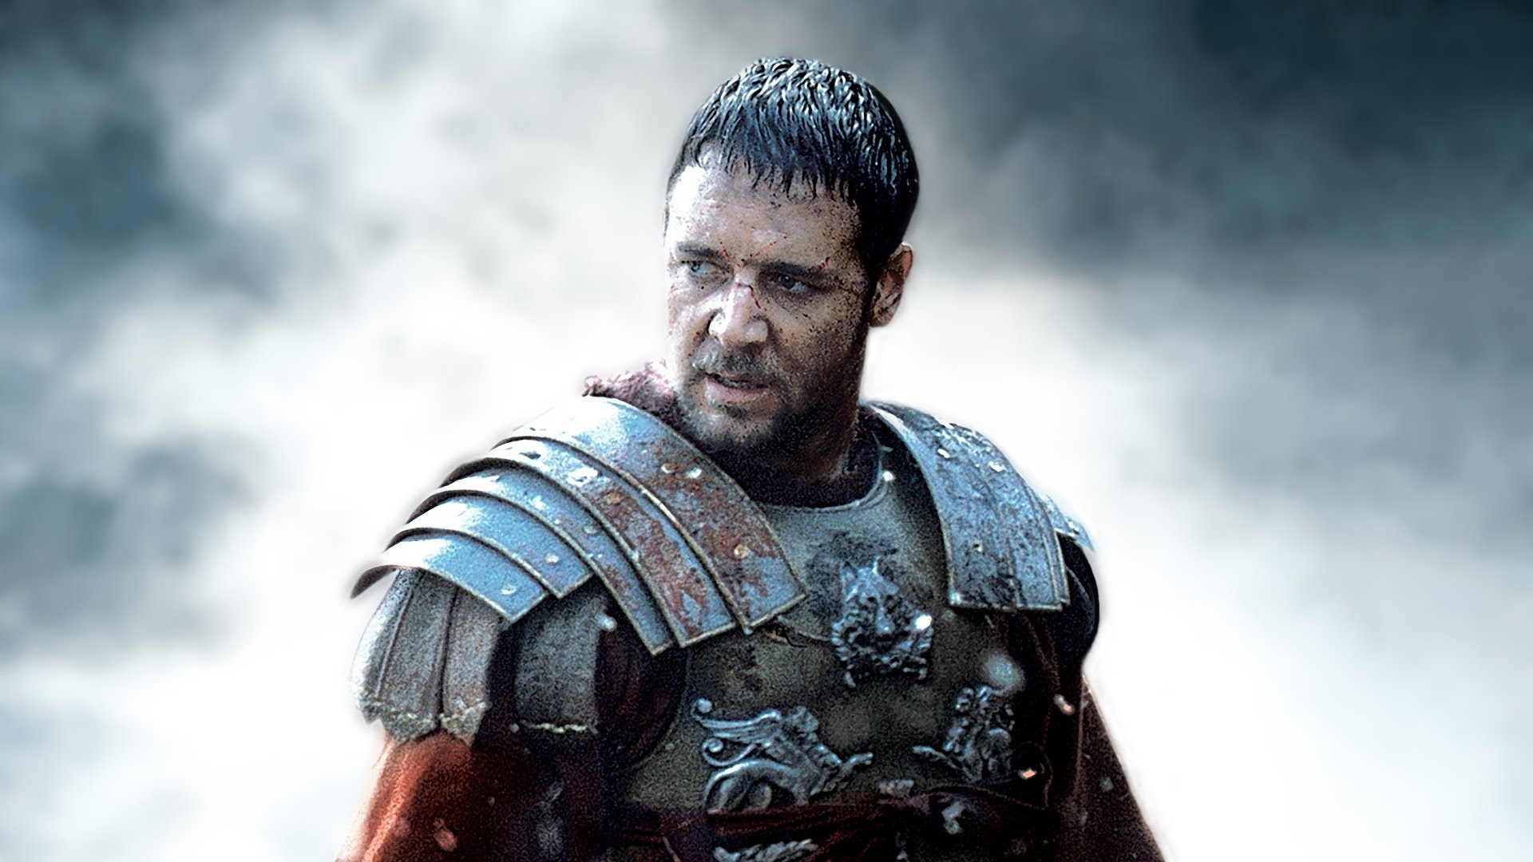
羅素·艾拉·克洛（英語：Russell Ira Crowe，1964年4月7日－），生於紐西蘭的知名澳洲電影演員。2000年，憑藉《神鬼戰士》奪得第73屆奧斯卡金像獎最佳男主角獎。2001年的作品《美麗境界》為他贏得了包括金球獎最佳男主角和英國電影學院獎最佳男主角在內的多個表演獎。Russell Crowe (1964 –) is an actor, film producer and musician from New Zealand. Although a New Zealand citizen, he has lived most of his life in Australia and identifies himself as an Australian.[1] He came to international attention for his role as the Roman General Maximus Decimus Meridius in the 2000 historical epic film Gladiator, directed by Ridley Scott, for which Crowe won an Academy Award for Best Actor, a Broadcast Film Critics Association Award for Best Actor, an Empire Award for Best Actor and a London Film Critics Circle Award for Best Actor and 10 further nominations for best actor.

Slide 9
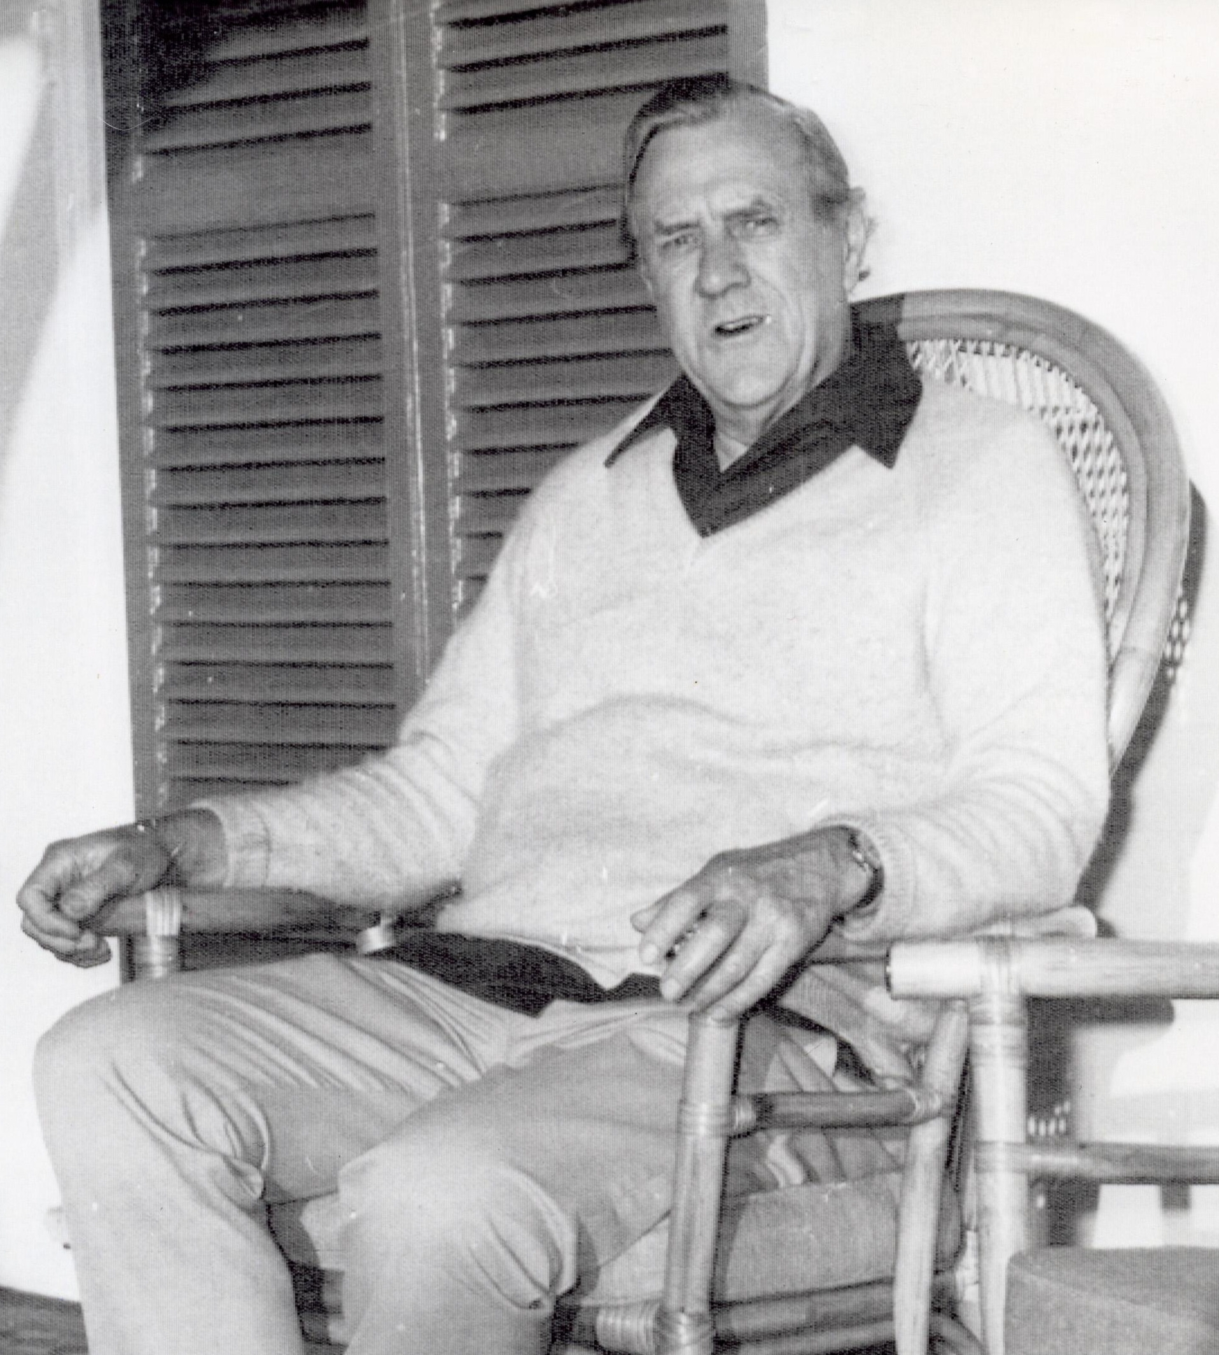
派屈克·懷特（Patrick White，1912－1990），澳大利亞小說家、劇作家，他被認為是20世紀最重要的英文作家之一。從1935年開始，他出版了12部小說、4部短故事集、8部劇本和非小說類文學作品。他的小說可以在情節性描寫和意識流間自由切換。1973年他獲得諾貝爾文學獎。Patrick White (1912 –1990) was an Australian writer who is widely regarded as one of the most important English-language novelists of the 20th century. From 1935 to his death, he published 12 novels, three short-story collections and eight plays. White's fiction employs humour, florid prose, shifting narrative vantage points and a stream of consciousness technique. In 1973, he was awarded the Nobel Prize in Literature, the first Australian to have been awarded the prize.

Slide 10
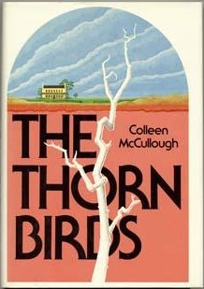
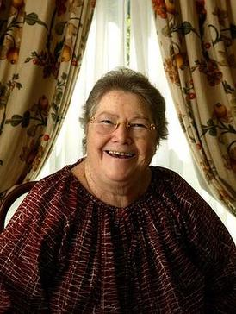
柯林·馬嘉露（1937－2015），出生於澳洲南威爾斯州，曾任美國康乃狄克州紐哈芬耶魯大學精神生理學教授。1977年著有《刺鳥》（The Thorn Birds）一書，成為澳洲最暢銷書。1997年被宣布為澳洲「活著的國寶」，定居英國劍橋。馬嘉露嗜抽菸，患有眼黃斑病變症，2003年9月左眼幾乎失明，右眼視力也急速退化中。2015年1月29日逝世[。Colleen McCullough's The Thorn Birds, 1977, is Australia's highest selling novel and one of the biggest selling novels of all time with around 30 million copies sold by 2009.

Slide 11
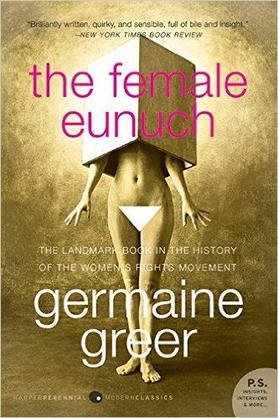
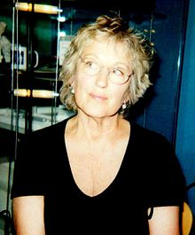
吉曼·基爾（1939－），澳洲出生的學者，作家及記者，被視為20世紀後期第二波女權運動重要的代表人物之一。她住在英國，在華威大學和劍橋大學紐納姆學院有學術職務。自她的第一本書《女太監》（1970年）出版後成為國際暢銷書她的觀點就引起了許多爭議，獲得了很多人的讚美或者反對。她出版了幾本關於女性，女權主義，文學，藝術和環境的書。Germaine 1939 –) is an Australian-born writer, regarded as one of the major voices of the second-wave feminist movement in the latter half of the 20th century.She lives in the United Kingdom, where she has held academic positions, specializing in English literature, at the University of Warwick and Newnham College, Cambridge. Greer's ideas have created controversy ever since her first book, The Female Eunuch (1970), became an international best-seller and made her a household name.

