Slide 1
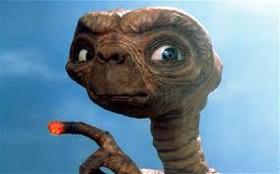
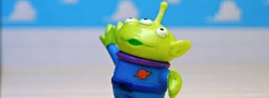
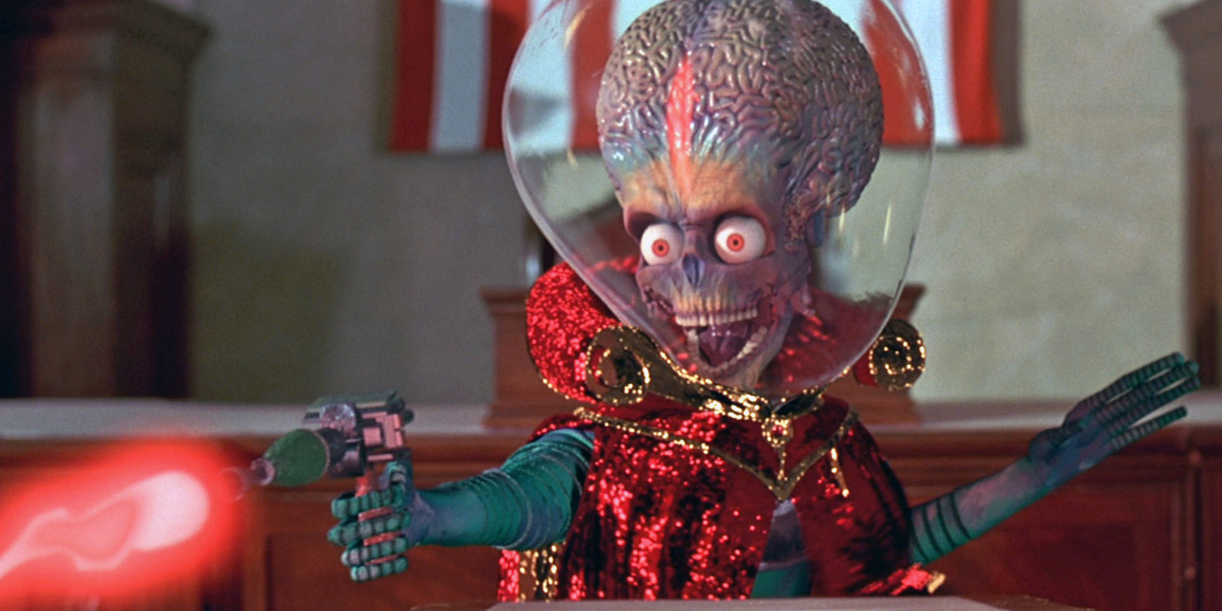
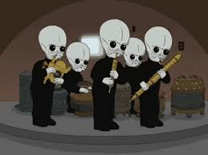
Aliens!

Slide 2
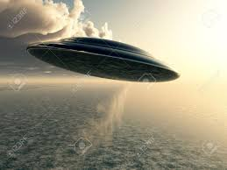
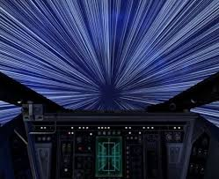
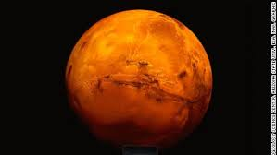
Alien
UFO
Spaceship
Light speed
Mars/Martians
Technology

Slide 3
What do you think aliens look like?
Do they have big heads?
Are they green?
Do they have small hands?
Write down what you think they look like.

Slide 4
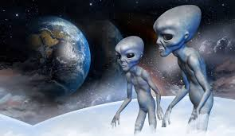
Pretend you are a space alien seeing Earth for the first time. You see people doing a strange Earth activity. Describe it in a few sentences. The class can guess what it is. Don’t tell us what they are doing!

Slide 5
-A man stands with a stick in his hands.
-He swings the stick at a tiny round thing.
-It flies very far.
-He tries to hit it into a hole with a flag in it.

