Slide 1
What is this article about?

Slide 2
What is this article about?
“Before marrying their partner, some men and women have to marry a tree first.”

Slide 3
What is a curse?

Slide 4
What is a curse?
“Unfortunately, the belief is that these people are cursed. What’s more, they will also curse whomever they marry to an early death.”

Slide 5
Can they break the curse?

Slide 6
Can they break the curse?
“Luckily, there is a solution. To break the curse, the manglik is first married to a peepul tree.”

Slide 7
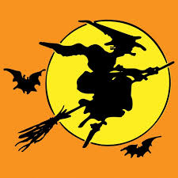
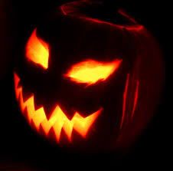
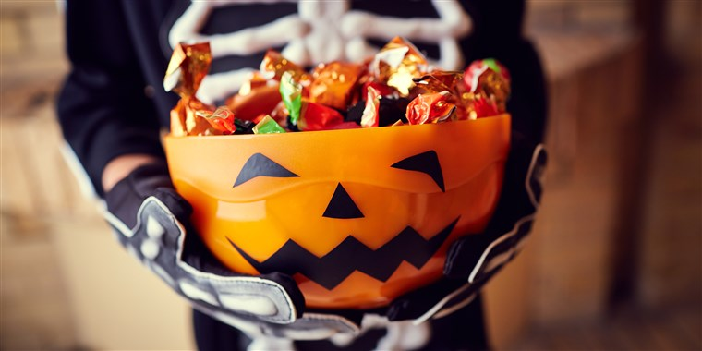
Halloween

Slide 8
Halloween
Monster
Vampire
Frankenstein
Ghost
Witch
Jack-o-lantern
Candy
Trick or Treat
Mummy
Clown

Slide 9
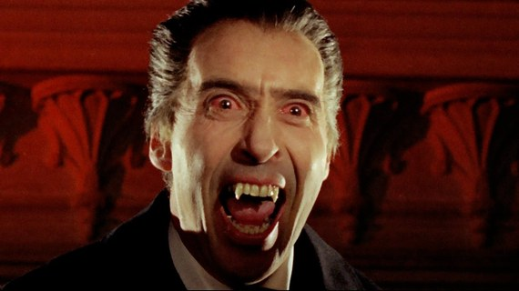
Name: Count Dracula (vampire)
From: Transylvania
Says: “I come to suck your blood!”
Hates: Sunlight, garlic, wooden stakes, crosses, holy water

Slide 10
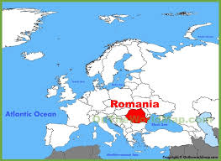
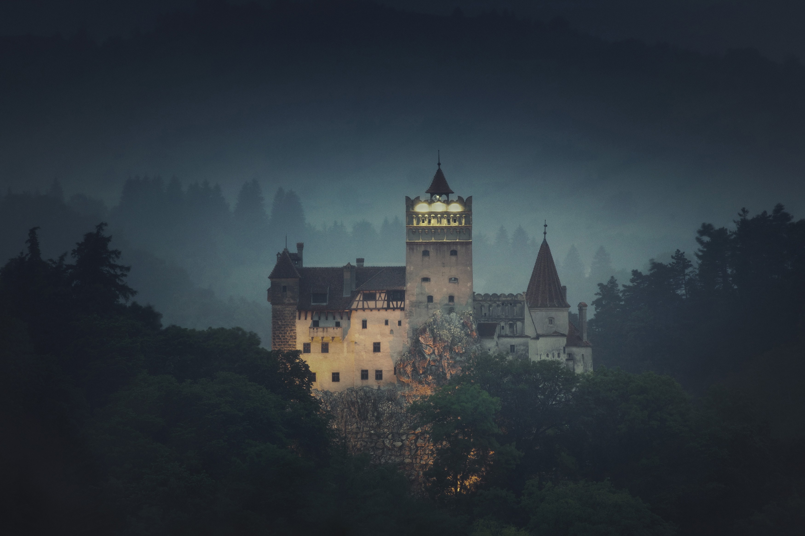
Transylvania

Slide 11
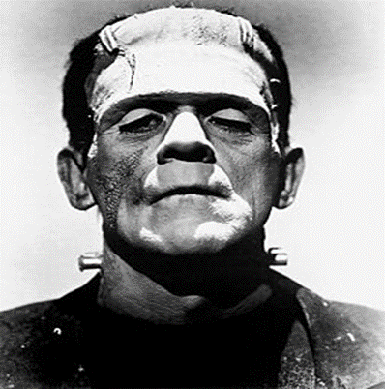
Name: Frankenstein’s monster
From: Germany
Attack: Looks scary; big and very strong.
Weaknesses: Scared of fire

Slide 12
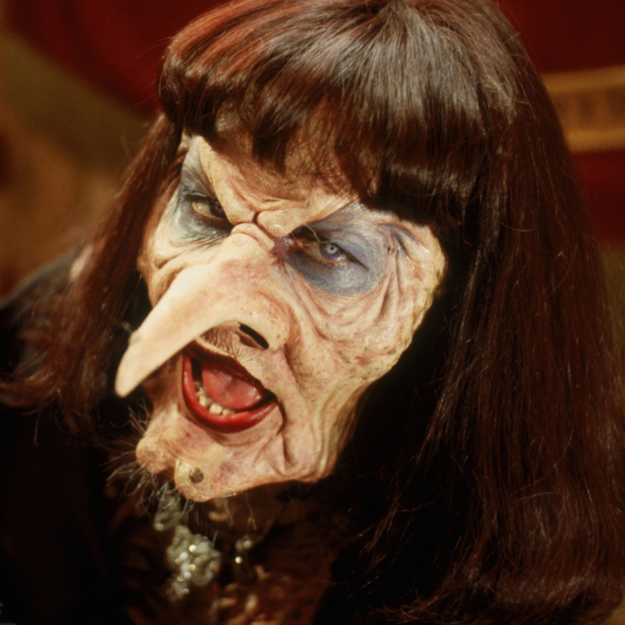
Name: Eva Ernst, The Grand High Witch
From: Norway
Hates: Children
Weakness: Children are more clever than she thinks.

Slide 13
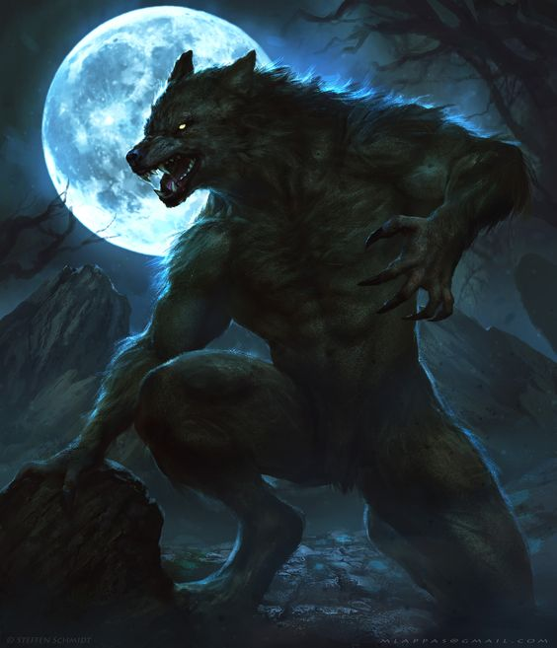
Name: Werewolf
From: Europe
Attack: Turns into a wolf with a full moon.
Weakness: Silver bullets

Slide 14
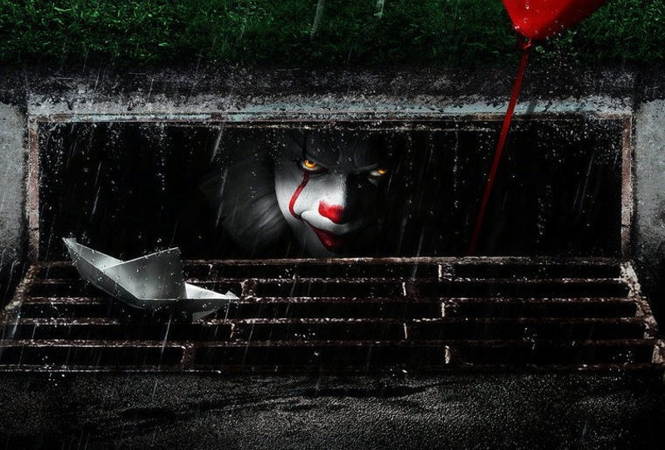
Name: It
Type: Scary Clown
Attack: Haunts dreams, has razor sharp teeth

Slide 15
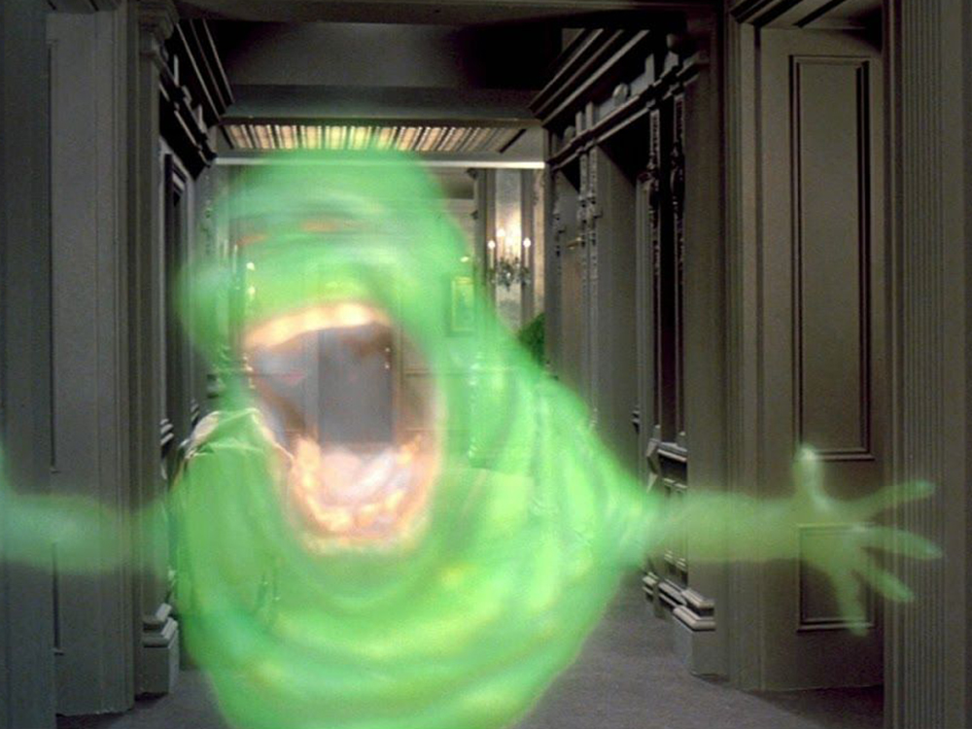
Name: Slimer (Ghost)
From: New York City (Ghostbusters)
Attack: Green, sticky slime!
Weakness: Technology

Slide 16
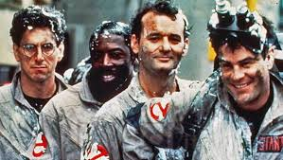
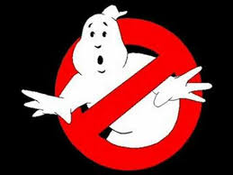

Slide 17
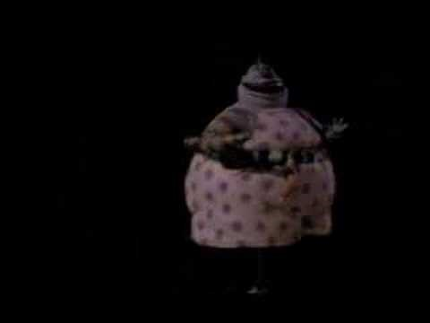

Slide 18
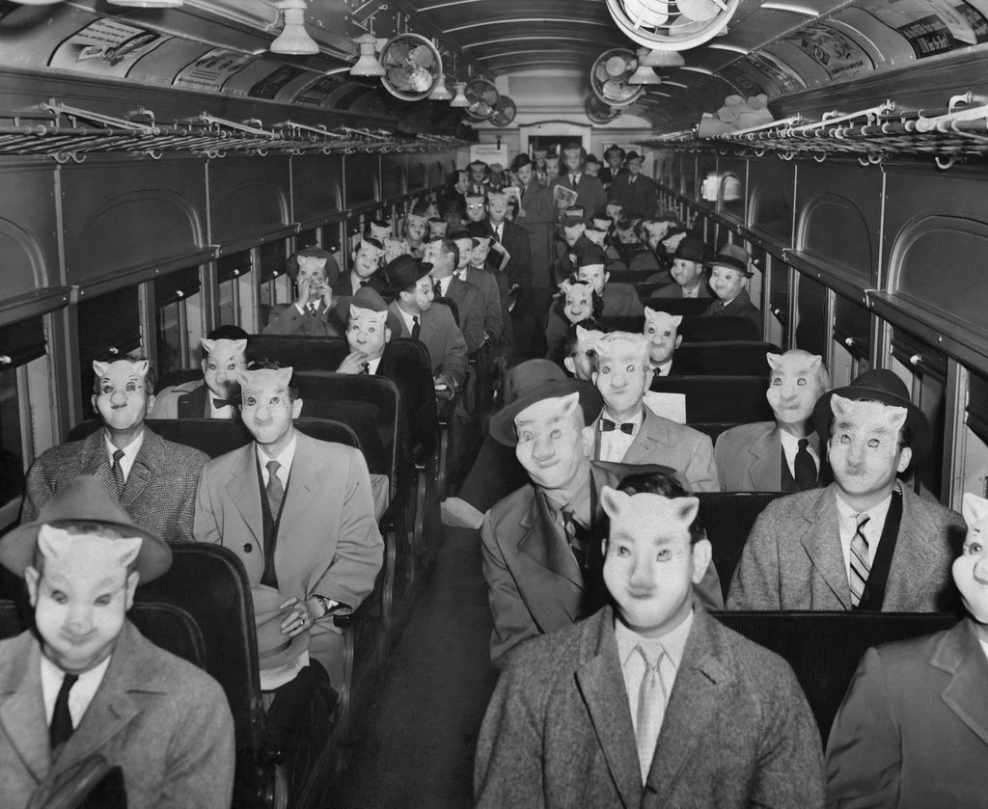

Slide 19
Halloween

