Slide 1
Vocabulary!
Classmate Waiter Farm
Doctor Kitchen
Nurse Farmer
Actor Cook
Theater Singer
Hospital Restaurant

Slide 2
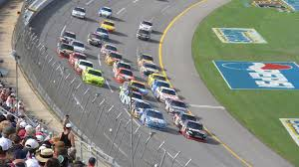
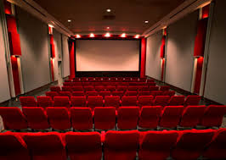
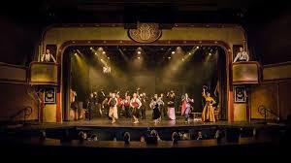
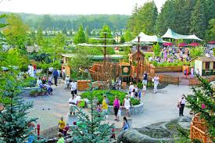
Theater

Slide 3
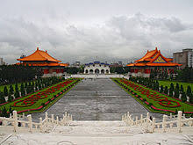
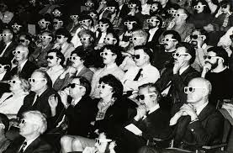
Theater

Slide 4
favorite
my
is
classmate’s
Star Wars
American
movie

Slide 5
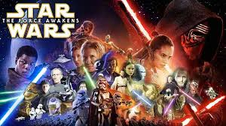
My classmate’s favorite American movie is Star Wars.

Slide 6
My classmate’s favorite American movie is Star Wars.
Star Wars is my classmate’s favorite American movie.

Slide 7
My classmate’s favorite American movie is Star Wars.
Star Wars is my classmate’s favorite American movie.
My American classmate’s favorite movie is Star Wars.

Slide 8
Question Words
Who?
What?
Where?
Why?
When?
How?

Slide 9
Vocabulary!
Classmate Waiter Farm
Doctor Kitchen
Nurse Farmer
Actor Cook
Theater Singer
Hospital Restaurant

Slide 10
List 1 List 2
Who? Restaurant
What?
Where?
Why?
When?
How?
List 3
Classmate
Doctor
Kitchen
Nurse
Farmer
Actor
Cook
Theater
Singer
Hospital
Restaurant
Waiter
Farm

Slide 11
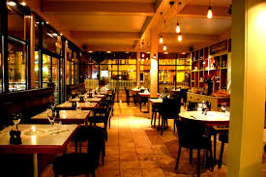
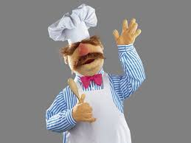
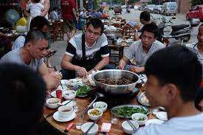
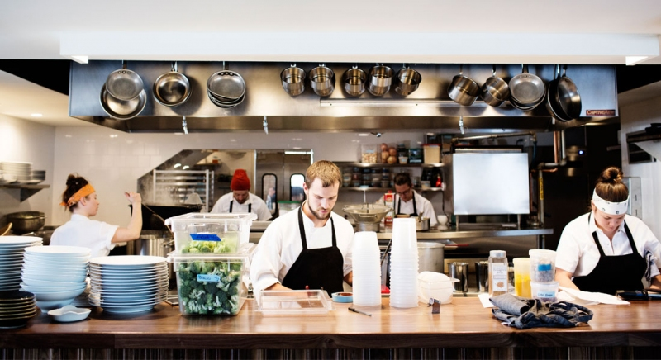
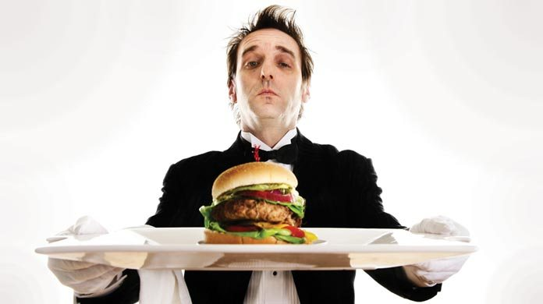
Restaurant

Slide 12
The ________ works at the theater.

Slide 13
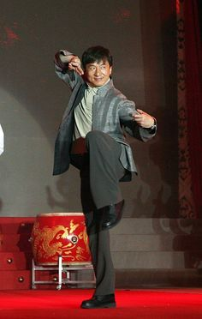
The actor works at the theater.

Slide 14
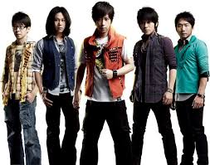
The actor works at the theater.
The singer works at the theater.

Slide 15
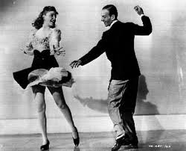
The actor works at the theater.
The singer works at the theater.
The dancer works at the theater.

Slide 16
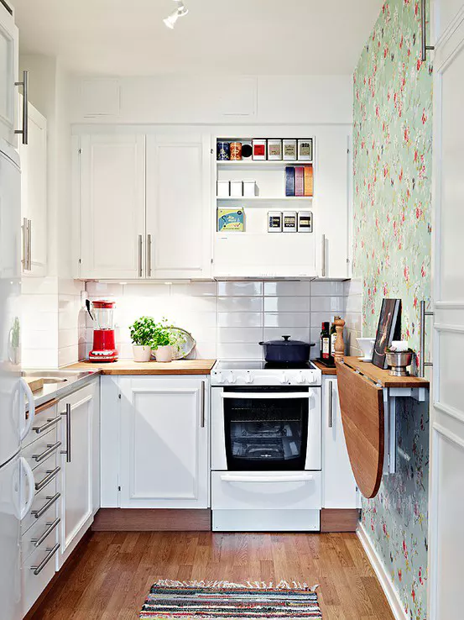

Slide 17
Kitchen

Slide 18
The ______ works in the restaurant.

Slide 19
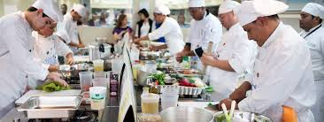
The cook works in the restaurant.

Slide 20
The cook works in the restaurant.
The waiter works in the restaurant

Slide 21
hospital
the
works
nurse
in
a
downtown

Slide 22
The nurse works in a hospital downtown.

Slide 23
The nurse works in a hospital downtown.
The nurse works in a downtown hospital.

Slide 24
The nurse works in a hospital downtown.
The nurse works in a downtown hospital.
The downtown nurse works in a hospital.

Slide 25
Vocabulary!
Classmate Waiter Farm
Police Officer Doctor Kitchen
Nurse Farmer
Actor Cook
Theater Singer
Hospital Restaurant

Slide 26
I ______ at the Thai food restaurant.

Slide 27
I like to eat at the Thai food restaurant.

Slide 28
Vocabulary!
Classmate Waiter Farm
Police Officer Doctor Kitchen
Nurse Farmer
Actor Cook
Theater Singer
Hospital Restaurant

Slide 29
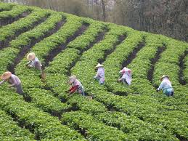
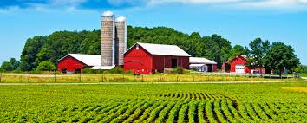

Slide 30
Farm

Slide 31
rarfme

Slide 32
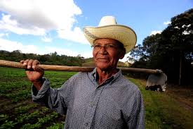
Farmer

Slide 33
What do you want to be when you grow up?

Slide 34
I want to be a _________when I grow up.

Slide 35
I want to be a _________when I grow up. How about you?

Slide 36
I want to be a _________.

Slide 37
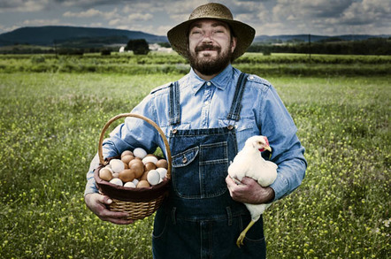
What does a farmer do?

Slide 38
Question:
Answer: I like to go to the movies.

Slide 39
Question: What do you like to do on weekends?
Answer: I like to go to the movies.

Slide 40
Question: What do you like to do on weekends?
Question: What is your hobby?
Answer: I like to go to the movies.

Slide 41
Question: What do you like to do on weekends?
Question: What is your hobby?
Question: What do you like to do with your friends?
Answer: I like to go to the movies.

