Slide 1
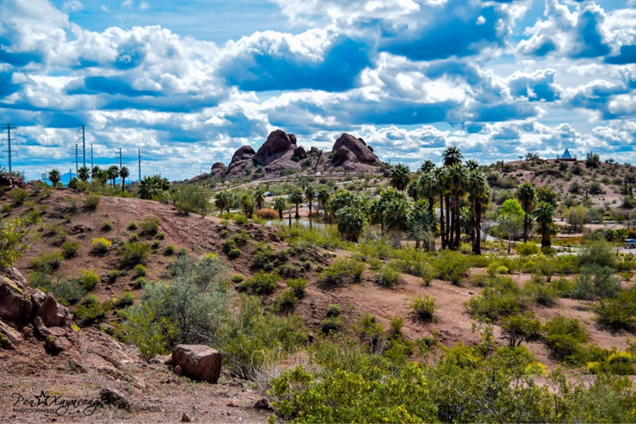
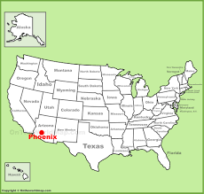
Jon Bonsall
Phoenix, Arizona

Slide 2
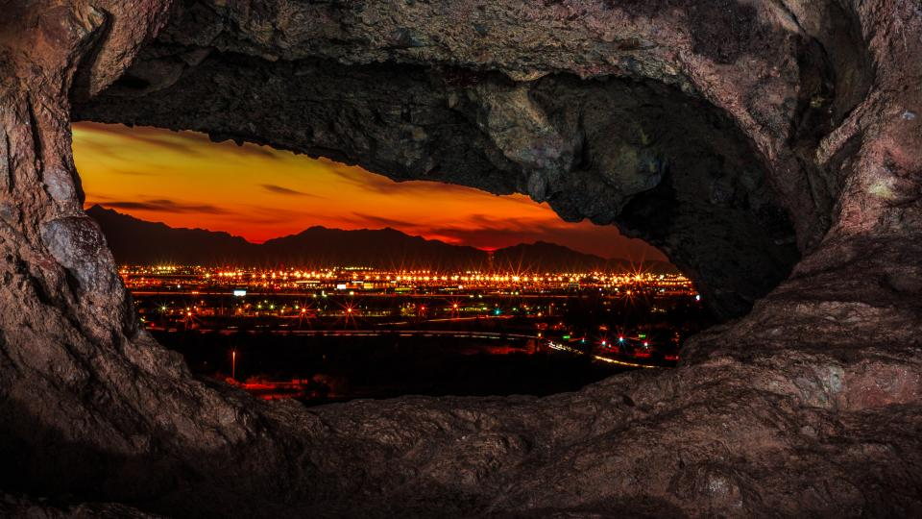

Jon Bonsall
Phoenix, Arizona
Hiking

Slide 3
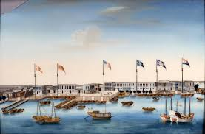
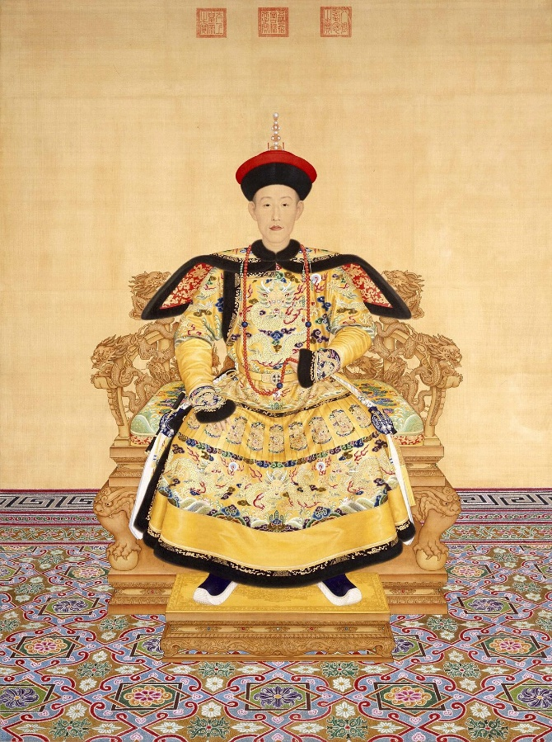
Jon Bonsall
Phoenix, Arizona
Hiking
Chinese History

Slide 4
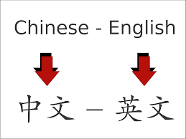
Jon Bonsall
Phoenix, Arizona
Hiking
Chinese History
Translating

Slide 5
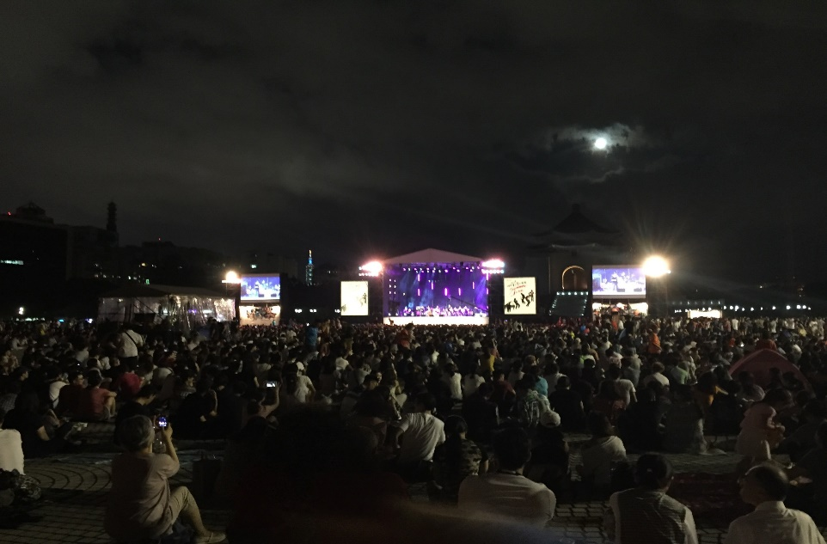

Jon Bonsall
Phoenix, Arizona
Hiking
Chinese History
Translating
Music

Slide 6
Classroom Words and Phrases:
Teacher
Student
Desk
Pencil
Paper
Book

Slide 7
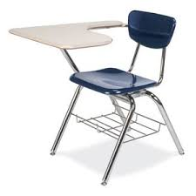
Classroom Words and Phrases:
Teacher
Student
Desk
Pencil
Paper
Book

Slide 8
Classroom Words and Phrases:
Desk

Slide 9

Classroom Words and Phrases:
Teacher
Desk
Pencil
Student
Paper
Book

Slide 10
Classroom Words and Phrases:
Student

Slide 11

Classroom Words and Phrases:
Teacher
Student
Desk
Pencil
Paper
Book

Slide 12
Classroom Words and Phrases:
Teacher

Slide 13
The __________ asked the __________ to open their ________.

Slide 14
The _teacher__ asked the __________ to open their ________.

Slide 15
The _teacher__ asked the ____students______ to open their ________.

Slide 16
The _teacher__ asked the ____students______ to open their ___books.

Slide 17
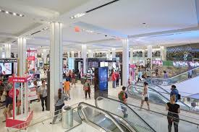
Airplane
Department Store
Castle
Barbecue
Dragon
Factory

Slide 18
Department Store

Slide 19
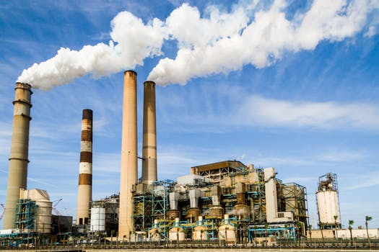
Airplane
Mansion
Castle
Barbecue
Dragon
Factory

Slide 20
Factory

Slide 21
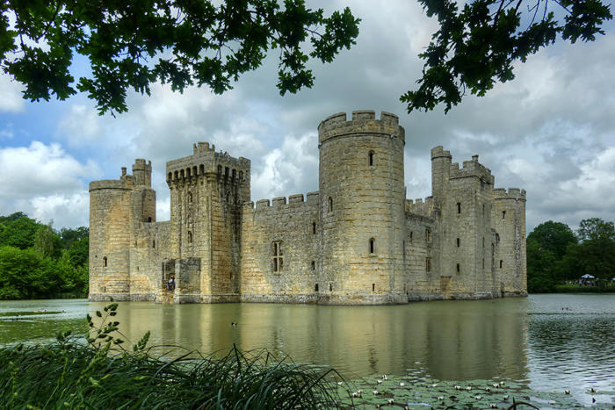
Airplane
Mansion
Castle
Barbecue
Apartment
Factory

Slide 22
Castle

Slide 23
My mother took me shopping for clothes at the _________.
Castle
Department Store
Factory
Apartment
Dragon

Slide 24
My mother took me to shop for clothes at the _________.
Department Store

Slide 25
The _________ makes bicycle parts.
Castle
Department Store
Factory
Apartment
Dragon

Slide 26
The _________ makes bicycle parts.
Factory

Slide 27
Daily Phrases
Introductions: How are you doing? What are you doing?
(It’s) Good to meet you. How’s it going? What’s up?
(It’s) nice to meet you. What’s new? What are you up to?
What’s your name? How have you been? What’s going on?
How are you? What’s happening?

Slide 28
A: How’s it going?
B: __________. How about you?
A: __________.

