Slide 1
Favorite World
Beautiful Hope
Really Fear
Great Share
Powerful Aware
Young Everyone

Slide 2
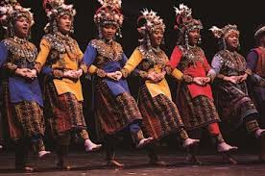
The people are dancing.

Slide 3
The people are dancing.
The people are singing.

Slide 4
The people are dancing.
The people are singing.
The people are dancing and singing.

Slide 5
The bus is taking the students to the school.

Slide 6
The bus is taking the students to the school.
The bus is powerful.

Slide 7
The bus is taking the students to the school.
The bus is big.
The students are young.

Slide 8
The bus is taking the students to the park.
The bus is big.
The students are young.
The big bus is taking the young students to the school.

Slide 9
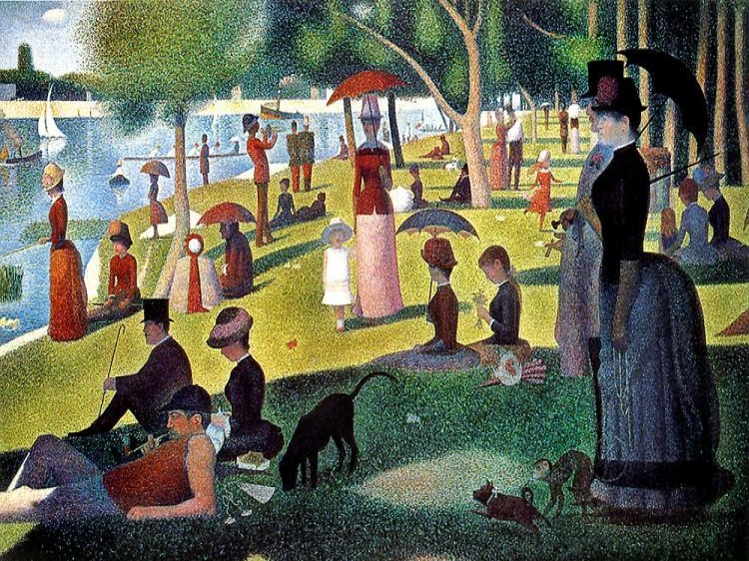
Favorite World
Beautiful Hope
Really Fear
Great Share
Powerful Aware
Young Everyone

Slide 10
Four lines
-A and B are talking
One line must be a question
You must use at least three vocabulary words

Slide 11
Example
A: Hello B. It’s a beautiful day today.
B: Yes, it is. Where is everyone?
A: I think they went to the movies.
B: Oh. I hope we will see them soon.

Slide 12
saw
dogs
lady
the
park
everyone
young
and
the
beautiful
to
the
man
take
powerful
their

Slide 13
Everyone saw the powerful man and the beautiful lady take their young dogs to the park.

