Slide 1
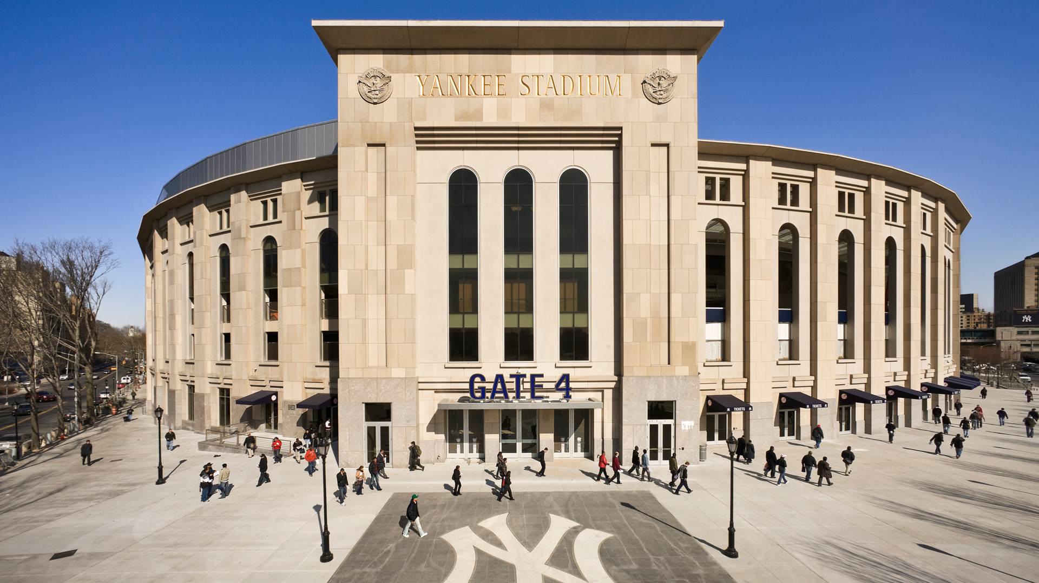
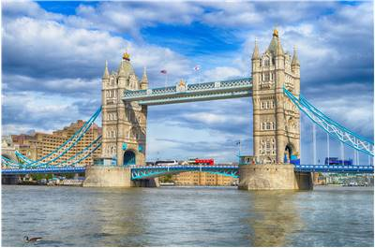
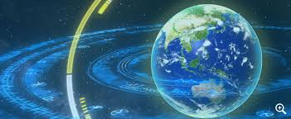
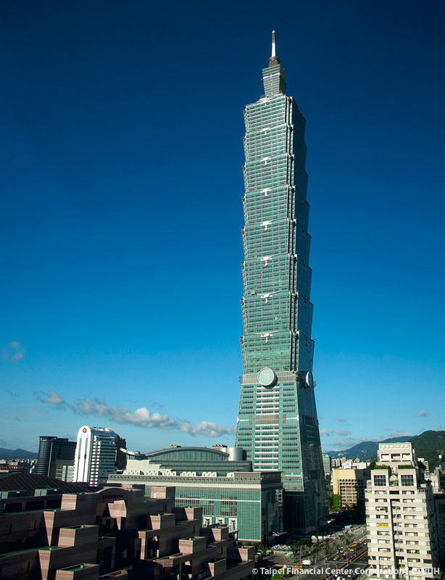
Hot checked-in places

Slide 2
Actor World Kitchen
Actress Restaurant Favorite
Movie Cook Really
Play Waiter Great
Theater Waitress Everyone

Slide 3

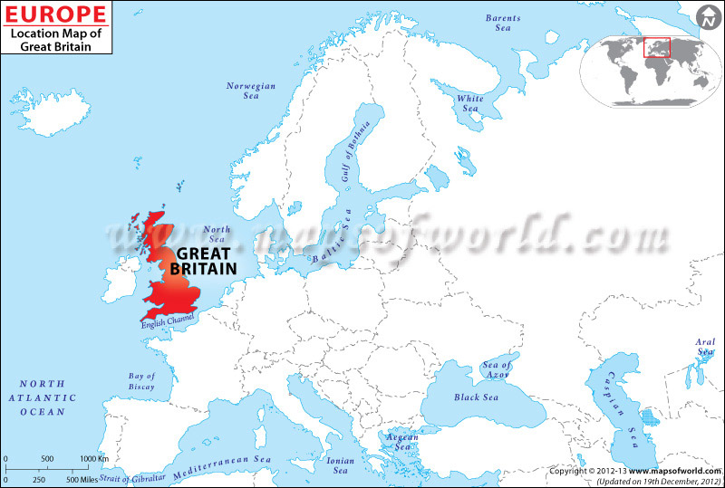
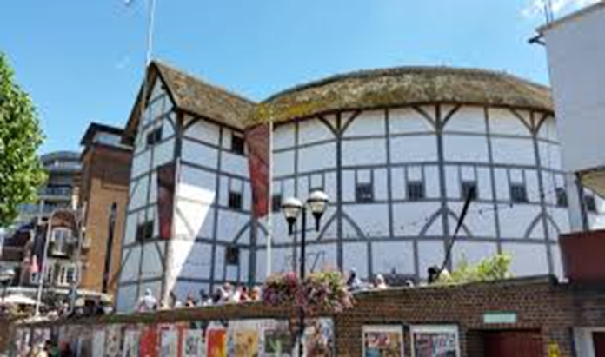
Great Britain
The Globe Theater

Slide 4
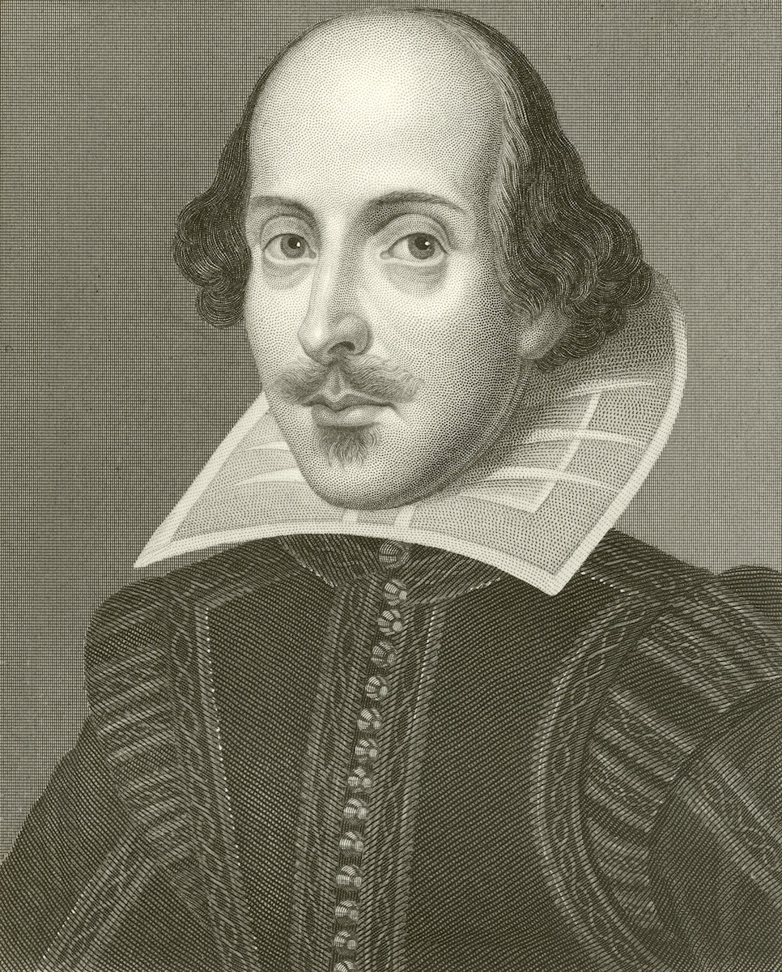

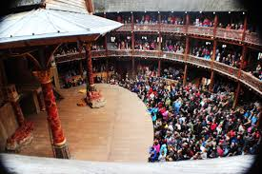
The Globe Theater

Slide 5
William Shakespeare

Slide 6
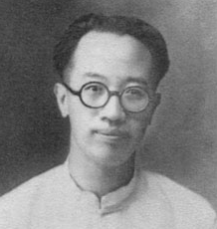
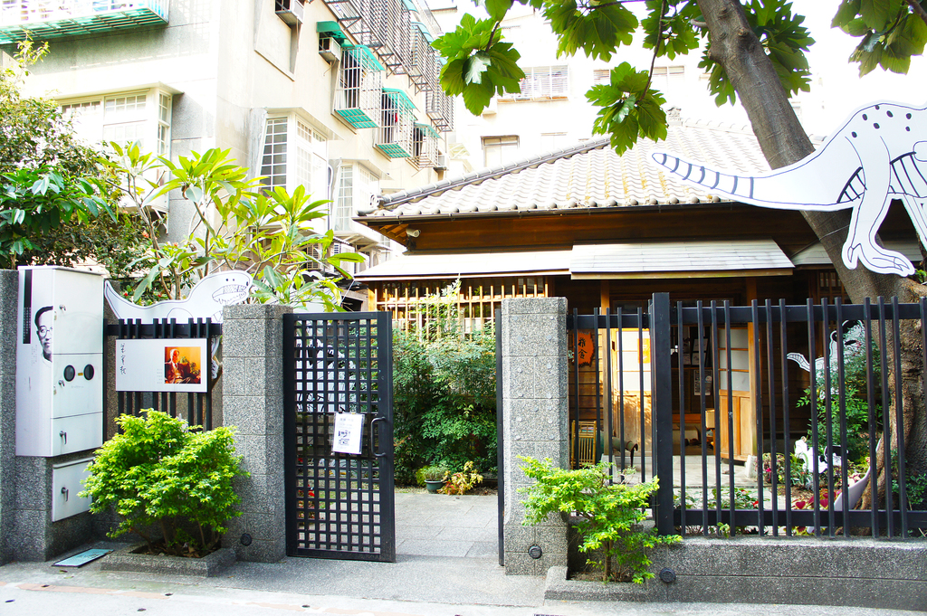
Liang Shiqiu
梁實秋

Slide 7
The actor acts on the stage.

Slide 8
The actor acts on the stage.
The actor acts well.

Slide 9
The actor acts on the stage.
The actor acts well.
The actor acts well on the stage.

Slide 10
The actor acts on the stage.
The actor acts well.
The actor acts well on the stage.
The actor acts on the stage well.

Slide 11

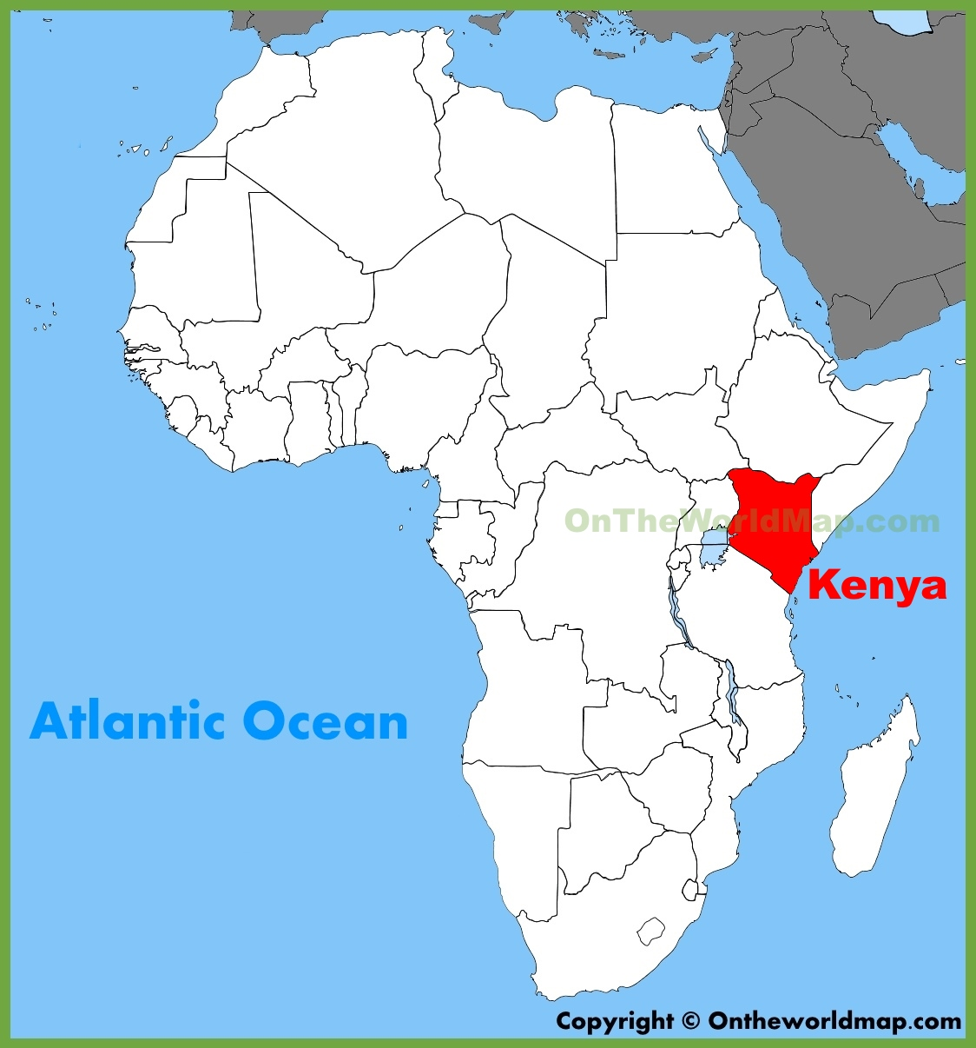
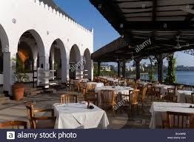
Kenya
Tamarind Restaurant

Slide 12
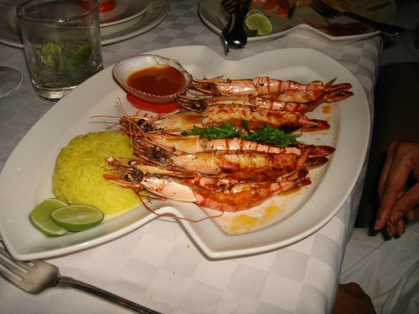
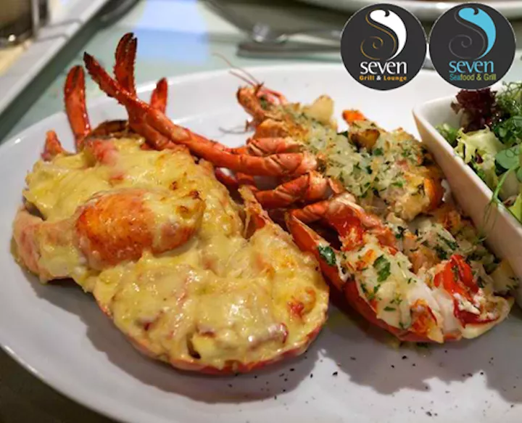
Tamarind Restaurant

Slide 13
Kitchen
Restaurant
Cook
Waiter
Waitress

Slide 14
Jerry likes to eat seafood.

Slide 15
Jerry likes to eat seafood.
Jerry likes to eat ice cream.

Slide 16
Jerry likes to eat seafood.
Jerry likes to eat ice cream.
Jerry does not like to eat beef.

Slide 17
Jerry likes to eat seafood.
Jerry likes to eat ice cream.
Jerry does not like to eat beef.
and but

Slide 18
Jerry likes to eat seafood.
Jerry likes to ice cream.
Jerry does not like to eat beef.
Jerry likes to eat seafood and ice cream, but he does not like to eat beef.

Slide 19
Jerry likes to eat seafood.
Jerry likes to ice cream.
Jerry does not like to eat beef.
Jerry likes to eat seafood and ice cream but not beef.

Slide 20
World
Favorite
Really
Great
Everyone

Slide 21
Group 1
Cook
Everyone
World
Group 2
Restaurant
Waiter
Really
Group 3
Everyone
Great
Restaurant
Group 4
World
Restaurant
Famous

Slide 22
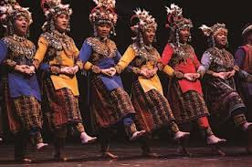
The people are dancing.

Slide 23
The people are dancing.
The people are singing.

Slide 24
The people are dancing.
The people are singing.
The people are dancing and singing.

