Slide 1
Question #1
According to the article, why do people go on a pilgrimage?

Slide 2
Question #1
According to the article, why do people go on a pilgrimage?
“In the past, it was often the only chance people had to leave their hometown. Nowadays, many people also take the trip as a way to do some soul-searching or to escape from daily life and experience nature.”

Slide 3
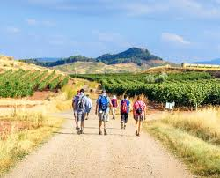
Question #2
Why is the Camino de Santiago so popular?

Slide 4
Question #2
Why is the Camino de Santiago so popular?
“The Camino de Santiago is actually made up of several different roads that all end at the Cathedral of Santiago de Compostela, an Amazing church in Spain where Saint James is said to be buried.”

Slide 5
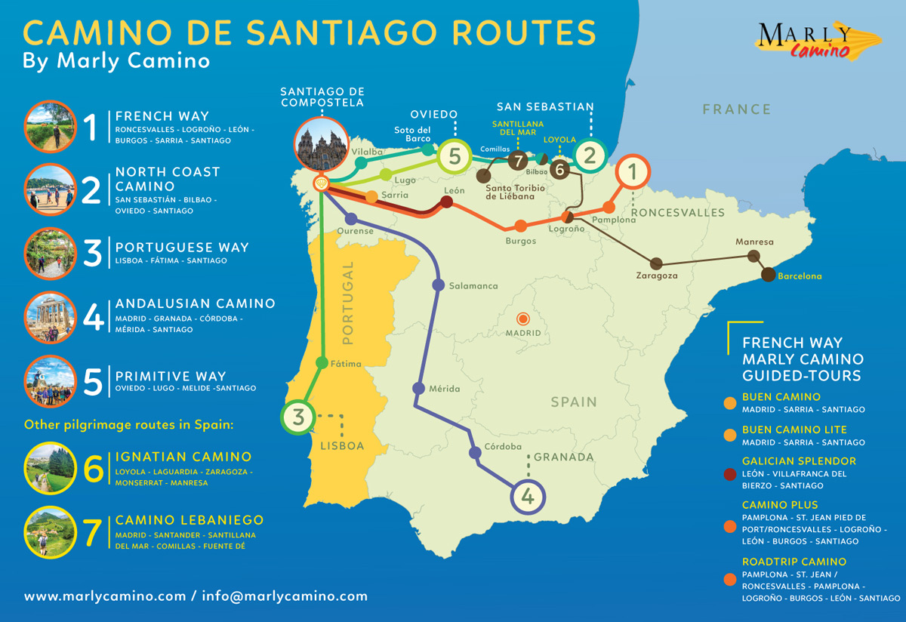
Question #3
How can someone travel on the Camino de Santiago?

Slide 6
Question #3
How can someone travel on the Camino de Santiago?
“While some may choose to bike or go on horseback instead of walking, this personal journey offers plenty of chances to take in beautiful views, explore ancient towns, and spend some time alone with your thoughts.”

Slide 7

Performance
In this lesson, students may pick a scenario from the box. Each scenario is about making a choice. Ask yourself: How many choices do you make each day? Why do you choose the things that you choose??

Slide 8
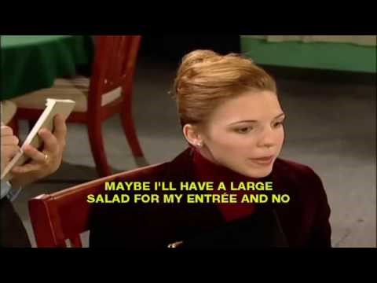

Slide 9
Questions:
What does Movember raise money for?
What is a “mo”?
How much money has Movember raised?

